Slide 1
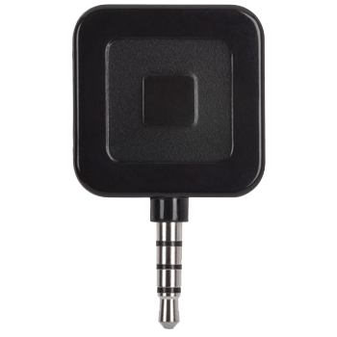
Square Card Reader
DIY Lecture 10
Kyle Cartechine
Notes:
Explore Square. ID its strengths and weaknesses. Identify at least one competing system. Find and cite a review article that compares Square with one of it’s competitors.

Slide 2
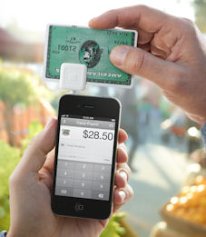
What’s this Square thing again?
Portable, mobile credit card reader for smart phones/tablets
Works with iOS 4.1 + and Android 2.1 +
Also use Square Register for iPads iOS 5.0 +
Notes:
What is it

Slide 3
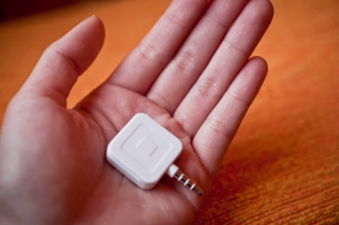
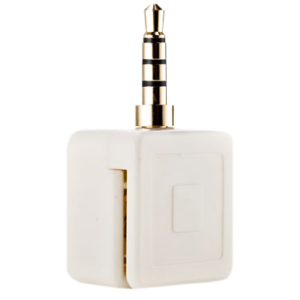
Square: Best Features
Small, light, fits in your palm or on a keychain
Sign up and get the device free
Fast and easy setup
Sign up
Download and install app
Plug Square into headphone jack
Start swiping all major cards
AmEx, Discover, MasterCard, Visa

Slide 4
Square: Best Features
Pay with Sqaure
Another app Pay with Square lets you set up payment from your phone
A tab or purchase can be setup before going to the business
Permits you to leave your wallet and/or phone home in some situations

Slide 5
Square: Worst Features?
It is a card handling service, so Square collects 2.75% commission per card swipe
Size of device increases risk of loosing it
It can be hacked and turned into a credit card skimmer?!
A great way for thieves to get your card number
What? I didn’t buy $200 worth of beef jerky!

Slide 6
Hackin’ the Square
First, how does it work?
It converts the credit card magstripe data into audio
Magstripe- the magnetic strip on the card
The installed app listens to the audio and translates it back into credit card numbers
Ah yes, therein lies the vulnerability!

Slide 7
Hackin’ the Square
Patch cable + software = data capture
Use a patch cable (3.5mm audio cable) and Makstripe software
Install Makstripe (software written by Adam Laurie years ago) on a laptop
Plug in cable to device and laptop
Use software to capture swiped card data
More on this from:
www.informationweek.com/news/security/vulnerabilities/231300283
Notes:
Adam Laurie (aka Major Malfunction) is a security researcher from Aperture Labs.

Slide 8
Square: Hackin’ Discontinued?
Updated with hardware encryption
Newer dongles include circuitry that encrypts the credit card data which is then converted to audio like before
Only the app should be able to decipher the data
Workaround: find an older dongle… on ebay?

Slide 9
Square’s Competition
Intuit GoPayment
PayPal Here
Both PayPal and Inuit have a free card reader and app like Square
Mophie marketplace phone cases
Only for iPhones
Case has card swipe integration
Macally SWIPEIT
Merchant Anywhere Pocket Verifier
Both of these are larger terminal style card swiper/readers

Slide 10
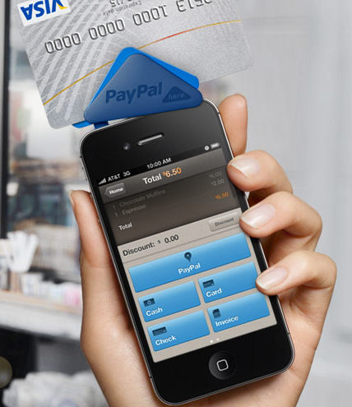
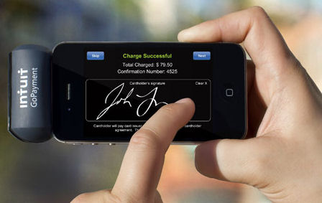
Square’s Competition

Slide 11
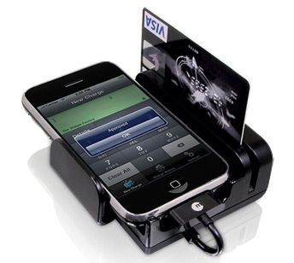
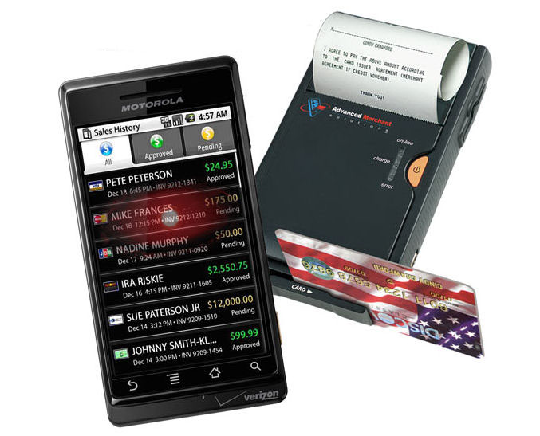
Square’s Competition

Slide 12
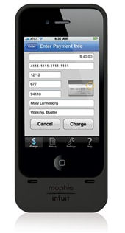
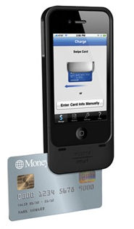
Square’s Competition

Slide 13
Square vs. Intuit
Square
Sign up, get free scanner
Has multiple apps for Android and iOS
Small reader
No lanyard
Multiple hardware support
Apps only work with Square unit
Hard to swipe, rotates easily
Inituit
Sign up, get free scanner
Has multiple apps for Android and iOS
Medium size reader
Comes with lanyard
Supports much less hardware
Apps work with other scanners (mophie)
Reviews say mophie case works best; it’s sturdy and has most reliable swipe
http://www.pcworld.com/businesscenter/article/239250/square_vs_intuit_gopayment_mobile_credit_card_systems_compared.html#tk.mod_stln

Slide 14
Resources
Square
https://squareup.com/?gclid=COai2Yi39a4CFYqc7QodcmaLLw
Square Vs Intuit
PCWorld Card Reader Comparison
Sqaure Gets Encryption
http://www.theverge.com/2012/3/28/2909699/square-dongle-hardware-encryption
Inuit
gopayment.com

Slide 15
Resources
Paypal Here
PayPal Here
SwipeIt
http://www.macally.com/en/product/ArticleShow.asp?ArticleID=330
Merchant Anywhere
http://www.merchantanywhere.com/
Mophie
www.mophie.com

Slide 16
Resources: Additional Images
Black Square
http://www.geekalerts.com/u/Square-Credit-Card-Reader.jpg
White Square
http://zapp3.staticworld.net/reviews/graphics/products/uploaded/square_card_reader_693414_g1.jpg
Square in Hand
http://photos.tracywongphoto.com/2011/01/11-square/square-004.jpg

